Slide 1
Apache Cassandra – An Introduction
Apache Cassandra was born at Facebook. After Facebook open sourced the code in 2008, Cassandra became an Apache Incubator project in 2009 and subsequently became a top-level Apache project in 2010.
It is a column-oriented database designed to support peer-to-peer symmetric nodes instead of the master−slave architecture.
It is built on Amazon’s dynamo and Google’s BigTable.
It is highly scalable, high performance distributed database
It is column oriented database designed to support peer to peer network
Adherance to availability and partition tolerance of CAP

Slide 2
Columnar databases are particularly advantageous for analytics queries that frequently scan or aggregate over large datasets but only need a few columns.
Because only the necessary columns are read from storage, I/O costs and time are minimized, providing an edge over traditional row-based databases in analytics scenarios.
For these use cases, columnar databases use system resources more efficiently and yield quicker insights.

Slide 3



Features:
Peer to Peer Network
-Designed to distribute and manage large data loads across multiple nodes in a cluster constituted of commodity hardware
-Does NOT have a master slave architecture-NOT have a single point of failure
-Graceful degradation where everything does not come crashing at any instant owing a node failure
Ensures data is distributed across all nodes in the cluster
Each node exchange information across the cluster every second

Slide 4
2. Gossip and Failure Detection
Gossip protocol is used for intra ring communication
Peer to peer communication protocol which eases the discovery and sharing of location and state information with other nodes in the cluster
A node only has to send out the communication to a subset of other nodes

Slide 5
3. Partitioner
A partioner takes a call on how to distribute data on the various nodes in the cluster
It also determines the node on which to place the very first copy of the data
A partitioner is a hash function is used to compute the token of the partion key

Slide 6
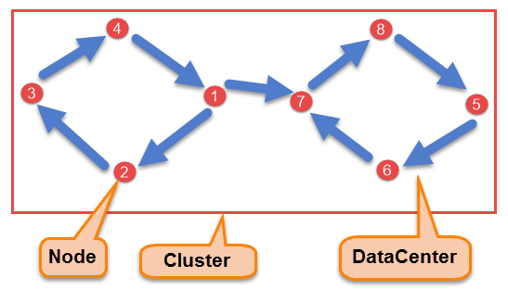
4. Replication factor
Node Node is the place where data is stored. It is the basic component of Cassandra.
Data Center A collection of nodes are called data center. Many nodes are categorized as a data center.
Cluster The cluster is the collection of many data centers.
rti

Slide 7
As hardware problem can occur or link can be down at any time during data process, a solution is required to provide a backup when the problem has occurred.
So data is replicated for assuring no single point of failure.
Cassandra places replicas of data on different nodes based on these two factors.
1. Where to place next replica is determined by the Replication Strategy.
2.While the total number of replicas placed on different nodes is determined by the Replication Factor.
One Replication factor means that there is only a single copy of data while three replication factor means that there are three copies of the data on three different nodes.
For ensuring there is no single point of failure, replication factor must be three.
There are two kinds of replication strategies in Cassandra.

Slide 8
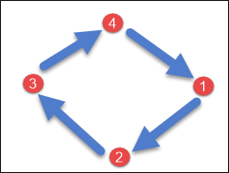
There are two kinds of replication strategies in Cassandra.
1. SimpleStrategy
SimpleStrategy is used when you have just one data center.
SimpleStrategy places the first replica on the node selected by the partitioner.
After that, remaining replicas are placed in clockwise direction in the Node ring.
Here is the pictorial representation of the SimpleStrategy.

Slide 9
2. NetworkTopologyStrategy
NetworkTopologyStrategy is used when you have more than two data centers.
In NetworkTopologyStrategy, replicas are set for each data center separately.
NetworkTopologyStrategy places replicas in the clockwise direction in the ring until reaches the first node in another rack.
This strategy tries to place replicas on different racks in the same data center.

Slide 10
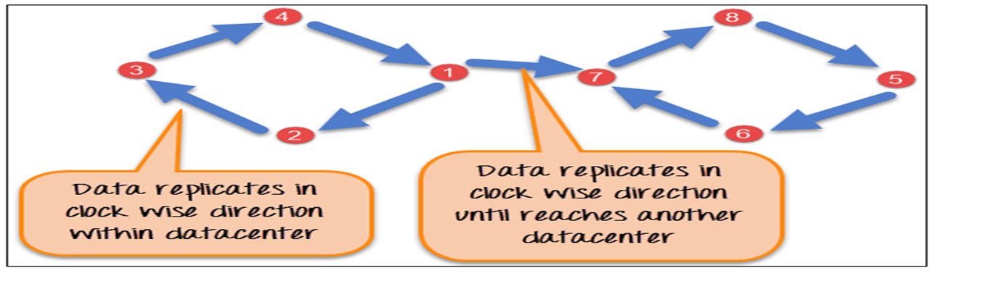
This is due to the reason that sometimes failure or problem can occur in the rack. Then replicas on other nodes can provide data.
Here is the pictorial representation of the Network topology strategy

Slide 11
Read consistency means how many replicas must respond before sending out the result to client application
Write consistency is how many replicas write must succeed before sending out an acknowledgement to the client application

Slide 12
5. Anti Entropy and Read Repair
A client can connect to any node in the cluster to read data
How many nodes will be read before responding to the client is based on the Consistency level specified by the client
If few of the nodes respond with an out of date value Cassandra will initiate a read repair to bring the replicas with stale values up to date
This is done using Anti Entropy gossip protocol.
Anti entropy implies comparing all the replicas of each piece of data and updating each replica to the newest version

Slide 13
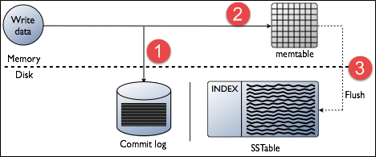
6. Write operation in Cassandra
When write request comes to the node, first of all, it logs in the commit log. Commit log is used for crash recovery.
A Write is taken as successful only if it is written to the commit log.
After data written in Commit log, the next step is to push the write to a memory resident data structure called Mem-table
Data written in the mem-table on each write request also writes in commit log separately.
Mem-table is a temporarily stored data in the memory while Commit log logs the transaction records for back up purposes or crash recovery
When mem-table has reached a threshold, data is flushed to the disk in a file called SSTable (Sorted String Table).

Slide 14




7. Hinted Handoffs
Three nodes A,B, C
C is down
Replication factor is 2
Write operation on node A which is the coordinator and serves as a proxy
When row k is wriiten by the client to Node A, it will write row K to node B and stores a hint for Node C.
Coordinator
Node C is down.
Write a hint in your table
A
Writes Row K
Client
System hints table
Replicates Row K
B
C
Hint has the following information
Location of the node on which replica is to be placed
Version Mtada
Actual data

Slide 15
8. Tunable Consistency
Strong Consistency- Each update propagates to all location where that piece of data resides. Assume a single data centre setup, Strong consistency ensures that all the servers that should have a copy of the data, will have it before the client is acknowledged with success. Performance impact is obvious with few extra milliseconds
Eventual Consistency- Client is acknowledged with success as soon as part of the cluster acknowledges the write.
The choice is obvious….when application performance matters the most
A single server acknowledges the write and then begins propagating the data to other servers

Slide 16
Consistency Levels:
Cassandra offers different consistency levels, and "QUORUM" is one of them.
Other levels include "LOCAL_QUORUM" (quorum within the same datacenter) and
"ONE" (at least one replica responds).
In Cassandra, a "quorum" refers to the minimum number of replicas that must respond to a read or write operation for it to be considered successful, calculated as (replication_factor / 2) + 1.
Replication Factor:
This determines how many copies of your data are stored across the cluster.
Quorum Calculation:
To achieve a quorum, Cassandra requires acknowledgement from a majority of the replicas for a given piece of data.
Example:
If your replication factor is 3, a quorum is 2 (3/2 + 1 = 2). This means at least two replicas
need to respond for a write or read operation to succeed.

Slide 17
Read Consistency
ONE | Returns a response from the closest node (replica) holding the data.
QUORUM | Returns a result from a quorum of servers with the most recent timestamp for the data.
LOCAL_QUORUM | Returns a result from a quorum of servers with the most recent timestamp for the data in the same data center as the coordinator node.
EACH_QUORUM | Returns a result from a quorum of servers with the most recent timestamp in all data centers.
ALL | This provides the highest level of consistency of all levels and the lowest level of availability of all levels. It responds to a read request from a client after all the replica nodes have responded.

Slide 18
Write Consistency
ALL | This is the highest level of consistency of all levels as it necessitates that a write must be written to the commit log and Memtable on all replica nodes in the cluster.
EACH_QUORUM | A write must be written to the commit log and Memtable on a quorum of replica nodes in all data centers.
QUORUM | A write must be written to the commit log and Memtable on a quorum of replica nodes.
LOCAL_QUORUM | A write must be written to the commit log and Memtable on a quorum of replica nodes in the same data center as the coordinator node. This is to avoid latency of inter-data center communication.
ONE | A write must be written to the commit log and Memtable of at least one replica node.
TWO | A write must be written to the commit log and Memtable of at least two replica nodes.
THREE | A write must be written to the commit log and Memtable of at least three replica nodes.
LOCAL_ONE | A write must be sent to, and successfully acknowledged by, at least one replica node in the local data center.

Slide 19
Cassandra - Data Model
The data model of Cassandra is significantly different from what we normally see in an RDBMS.
Cluster
Cassandra database is distributed over several machines that operate together.
The outermost container is known as the Cluster.
For failure handling, every node contains a replica, and in case of a failure, the replica takes charge.
Cassandra arranges the nodes in a cluster, in a ring format, and assigns data to them.

Slide 20
Keyspace
Keyspace is the outermost container for data in Cassandra. The basic attributes of a Keyspace in Cassandra are −
Replication factor − It is the number of machines in the cluster that will receive copies of the same data.
Replica placement strategy − It is nothing but the strategy to place replicas in the ring. We have strategies such as simple strategy (rack-aware strategy), old network topology strategy (rack-aware strategy), and network topology strategy (datacenter-shared strategy).
Column families − Keyspace is a container for a list of one or more column families.
A column family, in turn, is a container of a collection of rows.
Each row contains ordered columns.
Column families represent the structure of your data.
Each keyspace has at least one and often many column families.

Slide 21
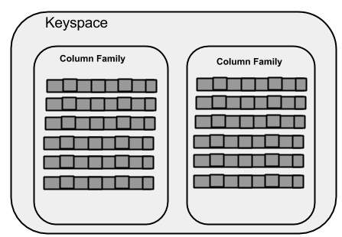
The syntax of creating a Keyspace is as follows −
CREATE KEYSPACE Keyspace name WITH replication = {'class': 'SimpleStrategy', 'replication_factor' : 3};
The following illustration shows a schematic view of a Keyspace.

Slide 22
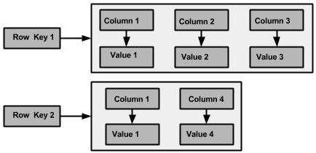
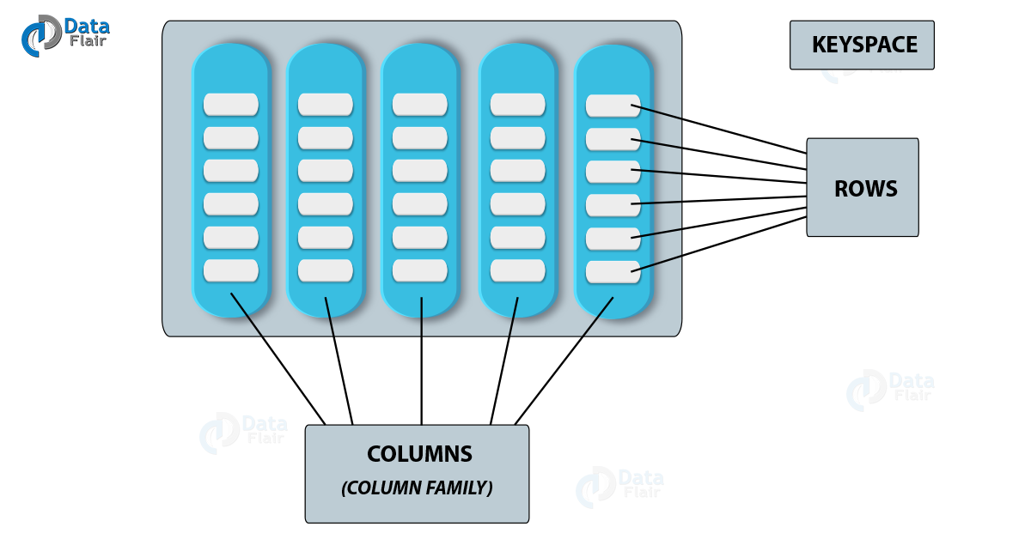
Column Family
A column family is a container for an ordered collection of rows. Each row, in turn, is an ordered collection of columns
The following figure shows an example of a Cassandra column family.

Slide 23
The following table lists down the points that differentiate the data model of Cassandra from that of an RDBMS.
RDBMS | Cassandra
RDBMS deals with structured data. | Cassandra deals with unstructured data.
It has a fixed schema. | Cassandra has a flexible schema.
In RDBMS, a table is an array of arrays. (ROW x COLUMN) | In Cassandra, a table is a list of “nested key-value pairs”. (ROW x COLUMN key x COLUMN value)
Database is the outermost container that contains data corresponding to an application. | Keyspace is the outermost container that contains data corresponding to an application.
Tables are the entities of a database. | Tables or column families are the entity of a keyspace.
Row is an individual record in RDBMS. | Row is a unit of replication in Cassandra.
Column represents the attributes of a relation. | Column is a unit of storage in Cassandra.
RDBMS supports the concepts of foreign keys, joins. | Relationships are represented using collections.

Slide 24
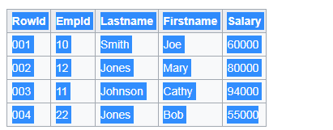
10:001,12:002,11:003,22:004;
Smith:001,Jones:002,Johnson:003,Jones:004;
Joe:001,Mary:002,Cathy:003,Bob:004;
60000:001,80000:002,94000:003,55000:004;

Slide 47
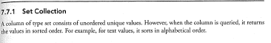
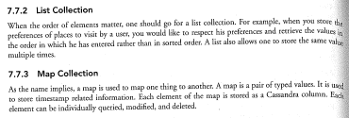
Set

Slide 48
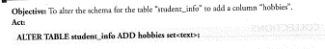
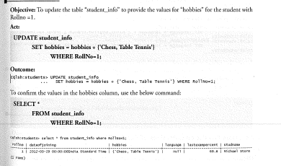

Slide 90
What Cassandra does not support
There are following limitations in Cassandra query language (CQL).
CQL does not support aggregation queries like max, min, avg
CQL does not support group by, having queries.
CQL does not support joins.
CQL does not support OR queries.
CQL does not support wildcard queries.
CQL does not support Union, Intersection queries.
Table columns cannot be filtered without creating the index.
Greater than (>) and less than (<) query is only supported on clustering column.Cassandra query language is not suitable for analytics purposes because it has so many limitations.
Create keyspace University

Slide 91
Create keyspace University with replication={'class':SimpleStrategy,'replication_factor': 3};
Create Student Table Student Rollno, Name, Dept

Slide 92
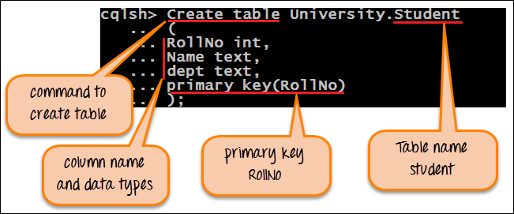
Alter table to add semester

Slide 93
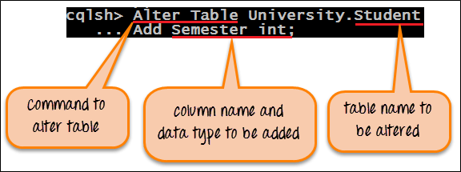
‘Alter Table’ that will add new column in the table Student.
Describe the table contents

Slide 94
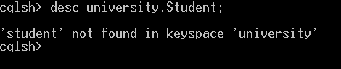
Insert the values into table and update student name of rollno 18

Slide 95
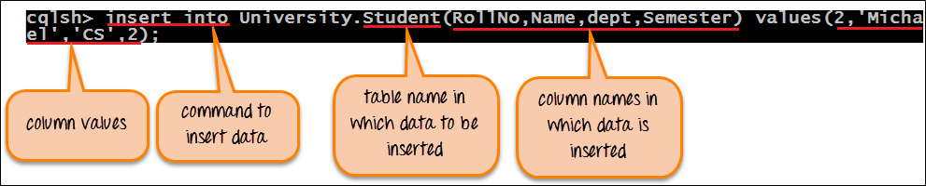
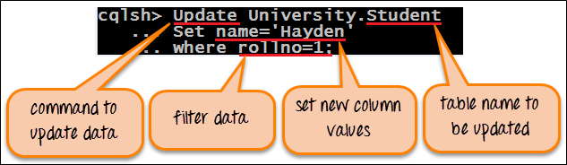
Delete the contents of rollno 1

Slide 96
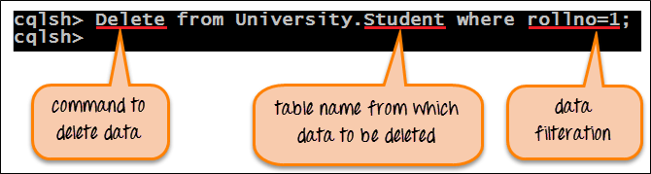
Select all CS dept students

Slide 97
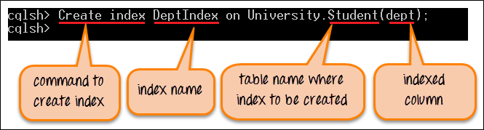
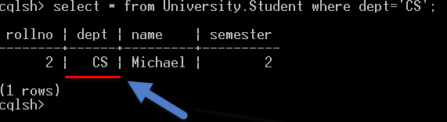
Remove index

Slide 98
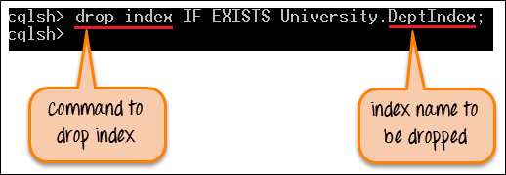
Create Teacher Table- Id, Name, Email

Slide 99
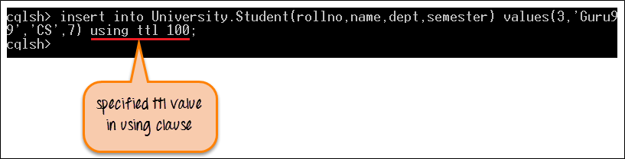
Set collection that store multiple email addresses for the teacher.

Slide 100
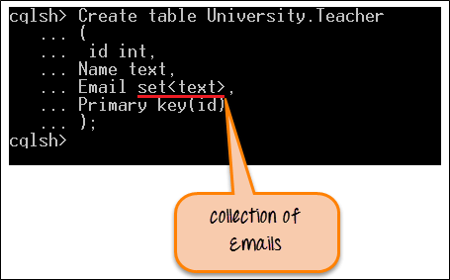
Add Courses to Teacher table

Slide 101
insert in column “coursenames”.

Slide 102
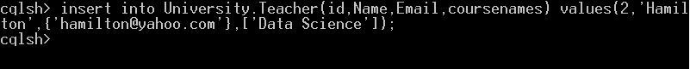
shows the current database state after insertion.

Slide 103
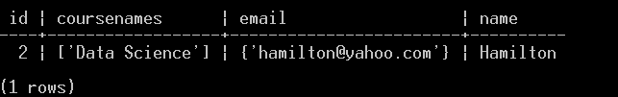
Write query when you want to save course name with its prerequisite course name

Slide 104
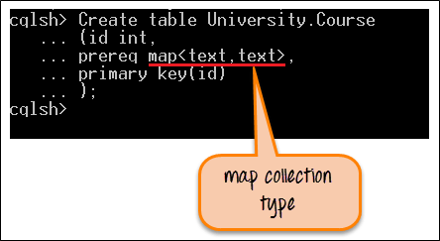
data is being inserted in map collection type

Slide 105
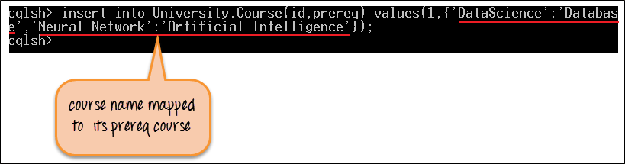
Remove the contents of table

Slide 106
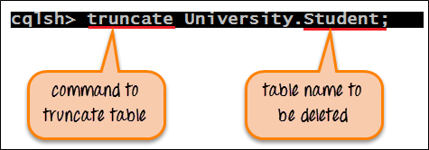
Drop table and Keyspace

Slide 107
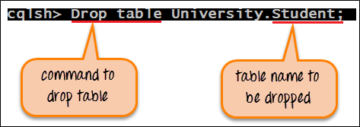
Drop keyspace University;

